Slide 1
Lending Club Loan Application Predictive Modeling Project
Abbas Qureshi
SpringBoard
Capstone Project

Slide 2

The Task at Hand
For the Capstone Project 1, I wanted to build a model that would predict whether a loan application would be a good candidate or a bad candidate. This process would help a company have a better ability in determining who to grant their loans to.
Lending Club is a company that receives loan applications and then allows investors to invest into the loan and receive a return from the loan being paid back.
But sometimes these loans are not paid back, this project will dive into deeper analysis and find a predictive model that could give a better accuracy as to who would have a better chance of paying back and who doesnt.

Slide 3
Hypothesis
My hypothesis is that a bad loan applicant would normally carry a high debt to income ratio, along with delinquency records in their history. From the dataset released from Lending Club I think I will have ample information to build a good model.

Slide 4
The DataSet
The dataset I have is directly from Lending Club acquired on Kaggle.com. This dataset has about 70-80 variables with about 800,000 rows. This should be an ample amount of information to build the right model for prediction. Some of the key variables in my initial impressions would be the past delinquencies, debt to income ratio, income, purpose, and home ownership.

Slide 5
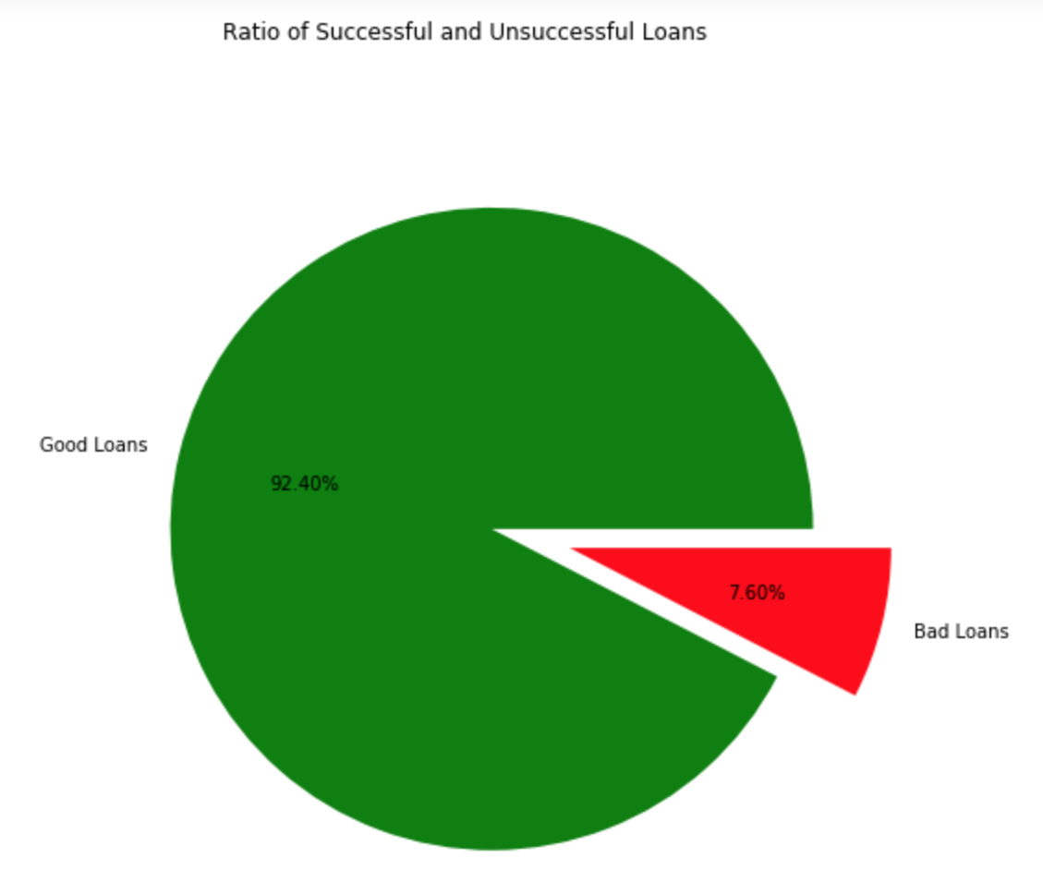
Good Loans vs. Bad Loans
At first I had differentiated between a good loan and a bad loan by separating the two categories from the variable “loan_status” where all entries with ‘Fully Paid’ are considered ‘good loans’ and the rest would go into the ‘bad loan’ category.
After that, I had plotted a Pie Chart to get a visual idea of the ratio between good loans and bad loans.
As we can see here 92% of the applications were good loans while 7% were bad, this seems like an adequate ratio between good loans and bad loans.

Slide 6
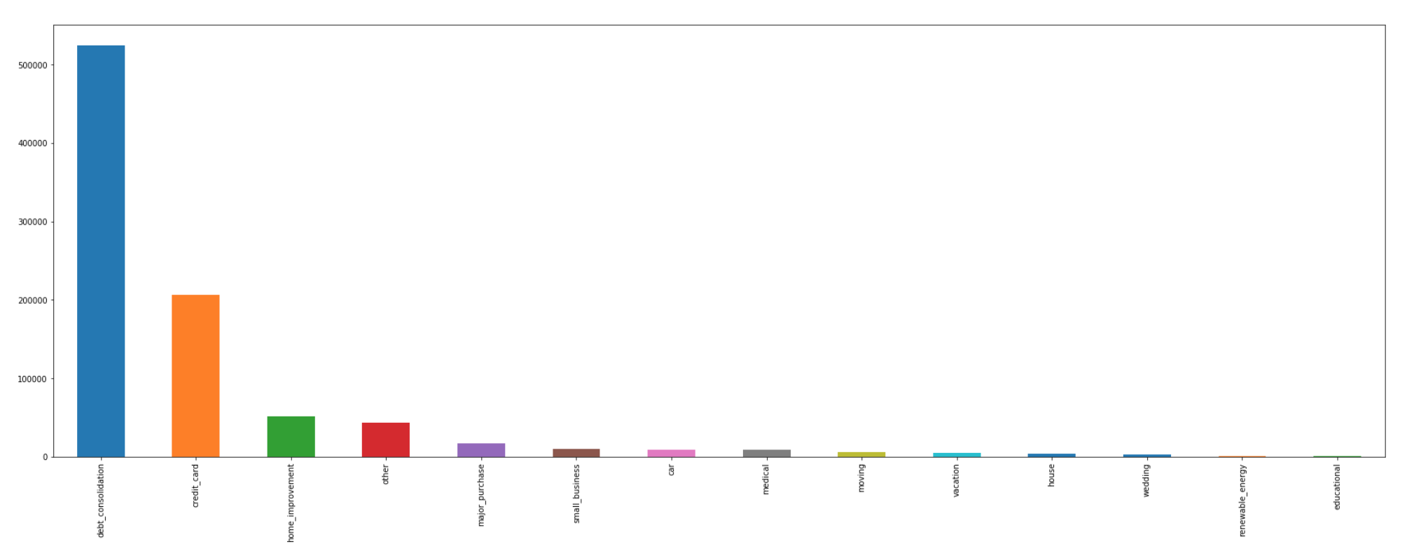
Purpose
From the purpose variable we can see that the vast majority of the loans are meant to consolidate debt. With debt consolidation and credit cards as top two, next comes home improvement. Afterwards there were plenty of entries suggesting debt consolidation in various other linguistic forms.

Slide 7
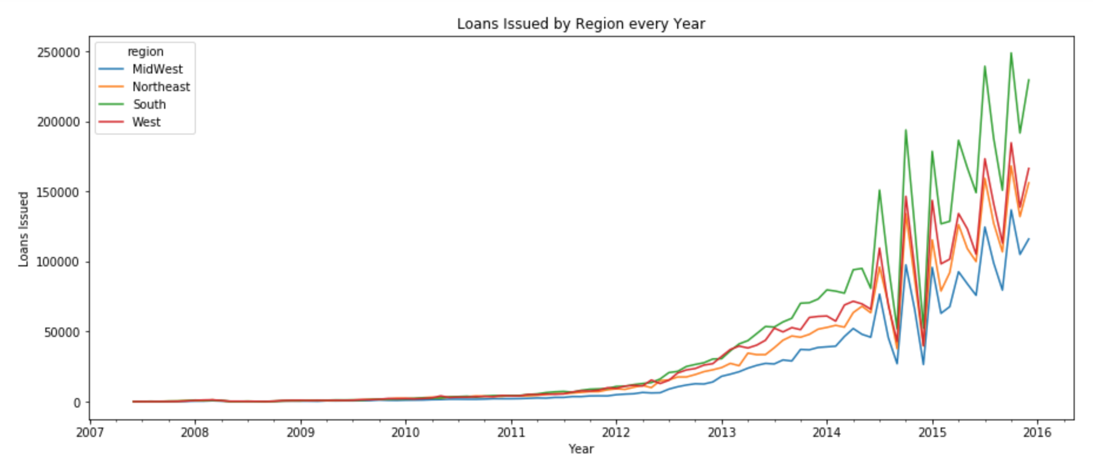
Region and Geography
We can see here the patterns of loans applied for are pretty much the same, however the southern region has more applicants displayed here. But since the pattern is the same there cant be much significance given to location.

Slide 8
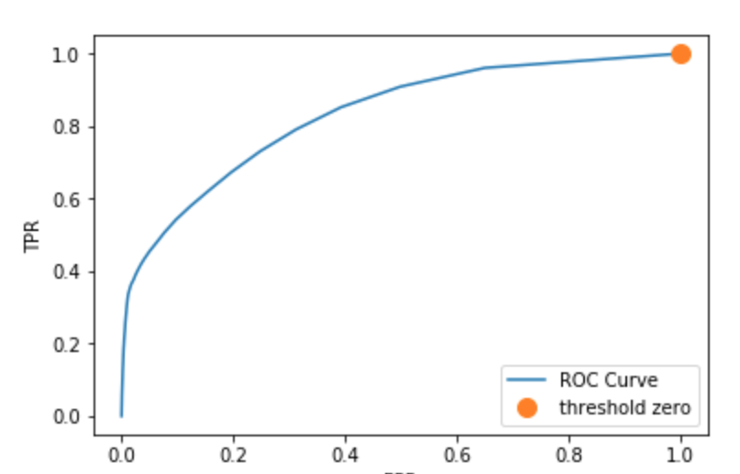
ROC Curve
After the machine learning algorithms were applied, I had plotted an ROC curve to get a visual on findings.
A good ROC curve would be indicative of the curve moving towards the top left corner of the graph, fortunately we have that scenario on this graph.

Slide 9
Final Thoughts
Now that the predictive model has been built, it seems the hypothesis was correct as well. Applicants with bad delinquency pasts and high debt to income ratio tend to have a harder time paying back loans. Alongside the other variables that were applied to this model, all three of the algorithms proved to be a success with an average accuracy of 95%. These algorithms were logistic regression, decision trees, and random forests. This model can be an effective tool for companies to use to determine what loan applicants can be successful and what applicants would not pay back.

